Slide 1
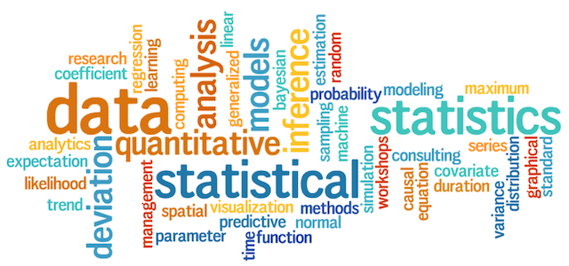

Statistics for Data Science with Examples

Slide 2
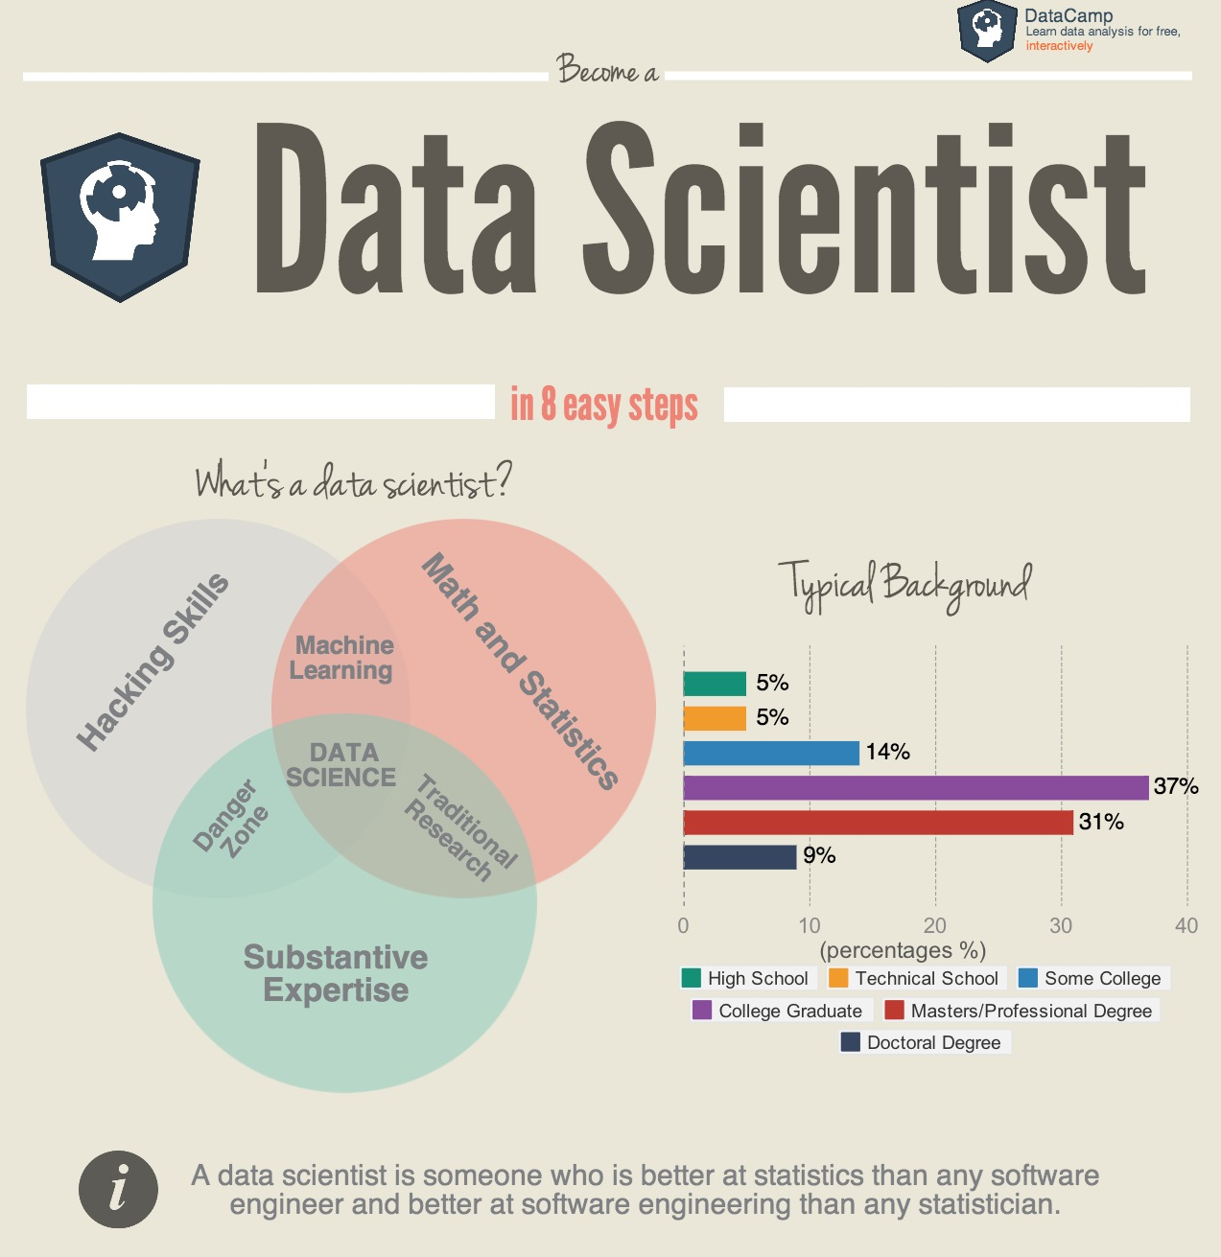
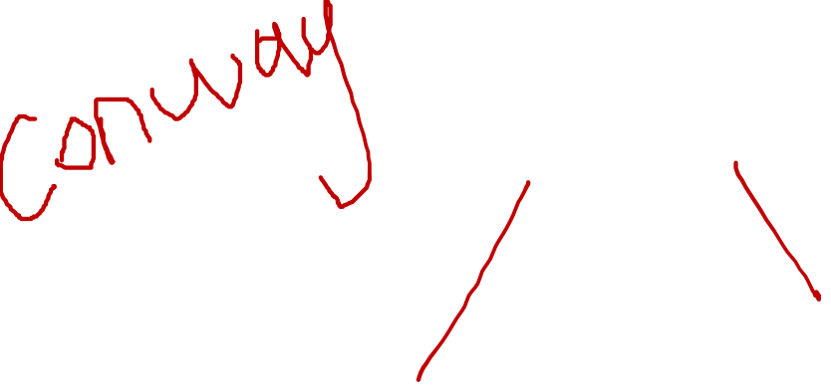
Data Scientist Skillset
“A data scientist is someone who is better at statistics than any software engineer and better at software engineering than any statistician.”
-- Josh Wills --
“Data science” lies at the intersection of statistics and computer science.

Slide 3
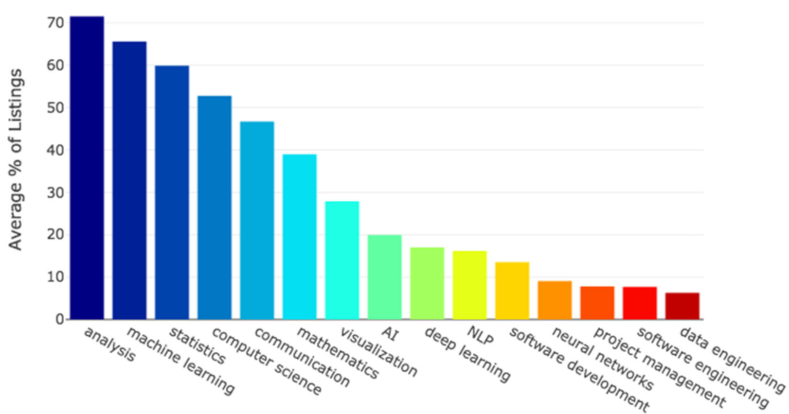
General Skills in Data Scientist Job Listings
Statistical analysis is the process of generating statistics from stored data and analyzing the results to deduce or infer meaning about the underlying dataset or the reality that it attempts to describe.
https://towardsdatascience.com/the-most-in-demand-skills-for-data-scientists-4a4a8db896db

Slide 4
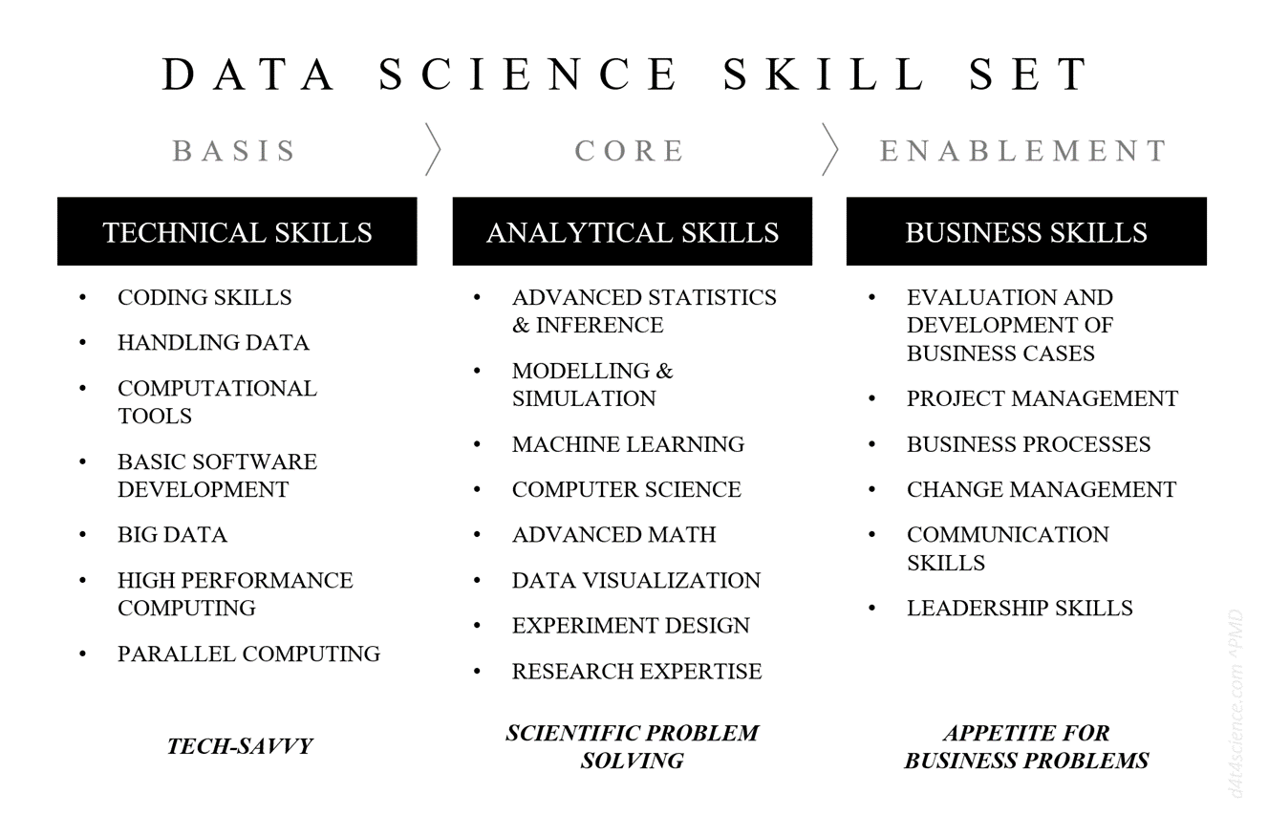

Slide 5
Learning Objectives
To explain the importance of statistical knowledge for data scientist.
To review the types and steps of statistical data analysis.
To discuss 7 key ideas from statistics that permeate data science
Samples and populations
Sample statistics
Bootstrap
Outliers
Statistical models
Confounding and accounting for other factors
p-values
To elaborate the concepts with some R examples.
To describe A/B testing.

Slide 6
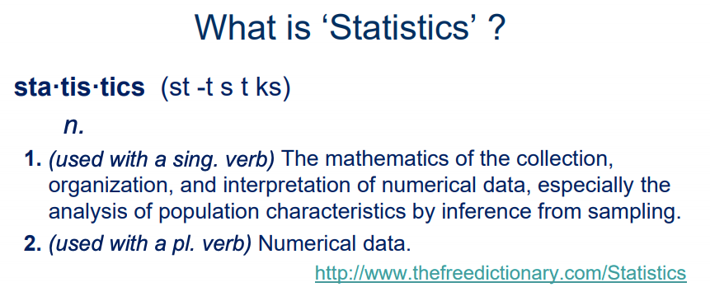
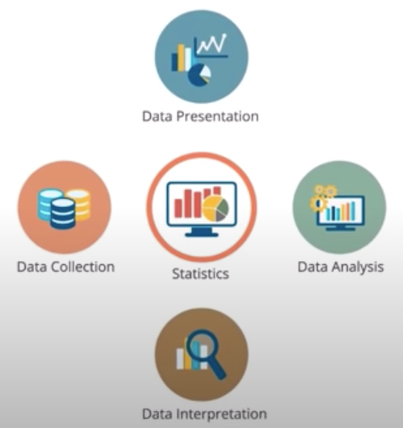
The science of learning from data.
Statistical knowledge helps us use the proper methods to collect the data, employ the correct analyses, and effectively present the results.
A crucial process behind how discoveries are made in science, make decisions based on data, and make predictions.
Allows us to understand a subject much more deeply.
6

Slide 7
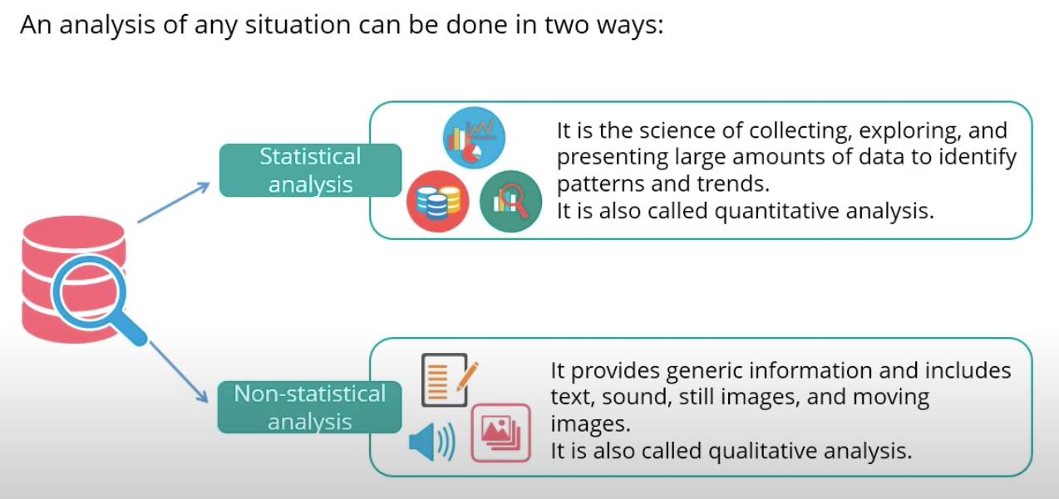
7

Slide 8
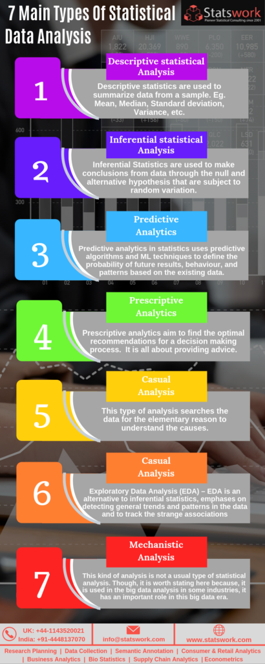
Statistical data analysis can be simplified into 5 steps, as follows:
The primary step involves the identification of the nature of the data to be analyzed.
Secondly, explore the association between the data and the underlying population in the study.
Build a suitable model to summarize the data and proceed for further analysis.
Check the validity of the model and take decisions about the hypotheses.
Explore predictive analysis to run situations that will guide us for future actions.
Causal
Analysis
Credit: Statswork.com

Slide 9
Inference Versus Prediction
There are situations where we are interested in understanding the way that Y is affected as X change.
In this situation we wish to estimate f, but our goal is not necessarily to make predictions for Y.
Here we are more interested in understanding relationship between X and Y. Now f cannot be treated as a black box, because we need to know its exact form.
This is inference.
In situations where a set of inputs X are readily available, but the output Y is not known, we often treat f as black box (not concerned with the exact form of f), as long as it yields accurate predictions for Y .
This is prediction.

Slide 10
Usage of Statistics for Data Scientist
Data scientist will use it for data analysis, experiment design, and statistical modelling.
Statistics is also essential for machine learning.
Use statistics to understand the data prior to training a model.
When taking samples of data for training and testing models, need to employ statistical techniques to ensure fairness.
When evaluating the performance of a model, statistics is needed to assess the variability of the predictions and assess accuracy.
“If statistics are boring, you’ve got the wrong numbers”
EDWARD TUFTE

Slide 11
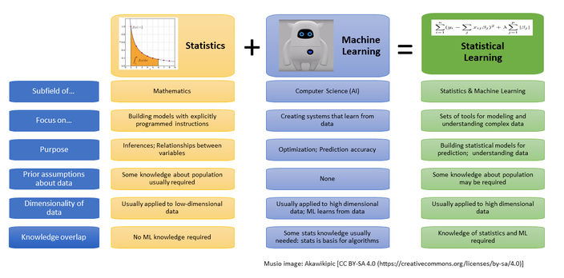
Statistical Learning
Statistical learning theory is a framework for machine learning drawing from the fields of statistics and functional analysis.
Statistical learning theory deals with the problem of finding a predictive function based on data.
https://www.datasciencecentral.com/profiles/blogs/machine-learning-vs-statistics-in-one-picture

Slide 12


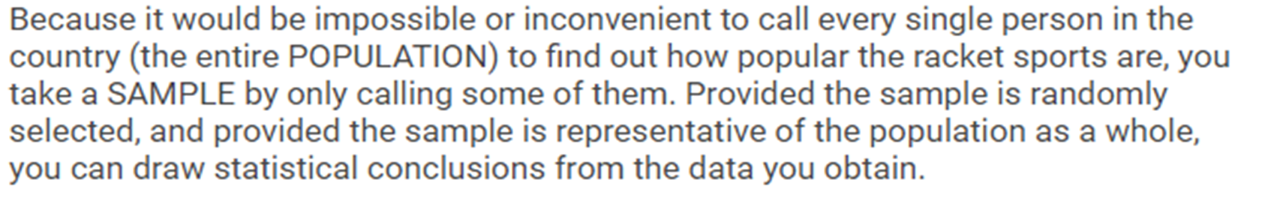
Test Your Statistical Knowledge
You are conducting a survey of the people in Malaysia to find out how popular the racket sports are. You randomly choose people to call, and make 1,000 phone calls to people scattered across the country.
In this study, what is the statistics term for THE PEOPLE IN MALAYSIA, and what is the statistics term for THE PEOPLE YOU CALLED?

Slide 13
Decide which descriptive statistics tool should you use according to the given situation.
Data type | Objective | Example | Statistical tools | Graphical tools
Quantitative One variable | Estimate a frequency distribution | How many students per batch fail to graduate on time? | Frequency table | Histogram
Quantitative One variable | Measure the central tendency of one sample | What is the average grade in a course? | Mean, median, mode | Box plot Scattergram Strip plot
Quantitative One variable | Measure the dispersion of one sample | How are the grades dispersed around the average grade in a course? | Range, Standard deviation, Variance, | Box plot Scattergram Strip plot
Quantitative Two variables | Describe the association between two variables | Does plant biomass increase or decrease with soil Pb content? | Correlation coefficients | Scatter plot Correlation map
Qualitative (univariate analysis) | Detect the most frequent category | Which is the most frequent eye color in Malaysia? | Mode | Bar chart Pie chart

Slide 14
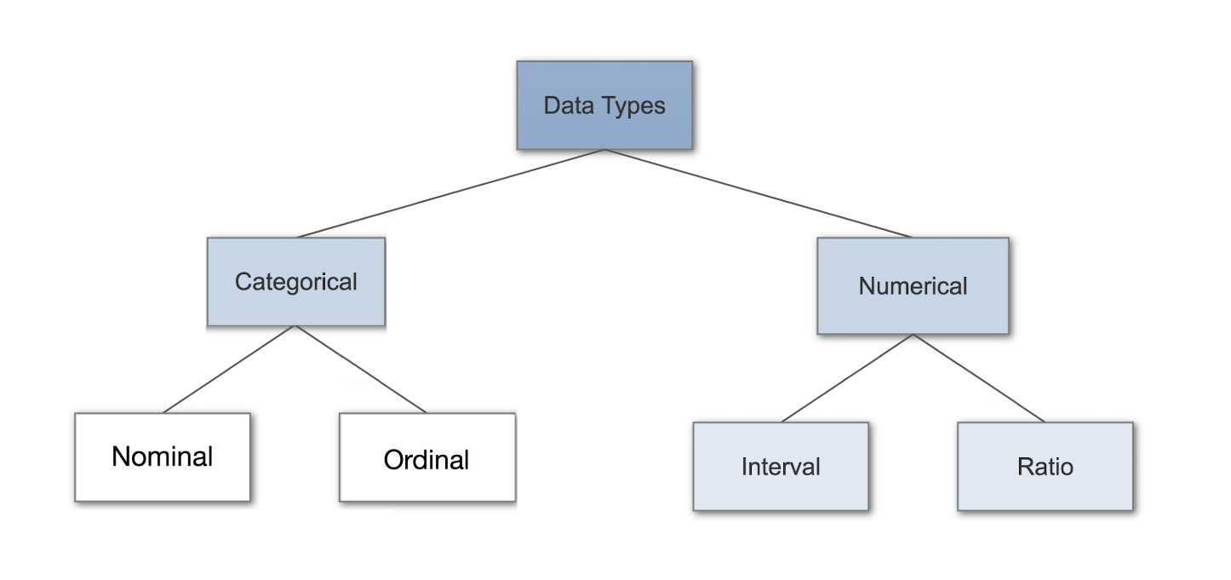
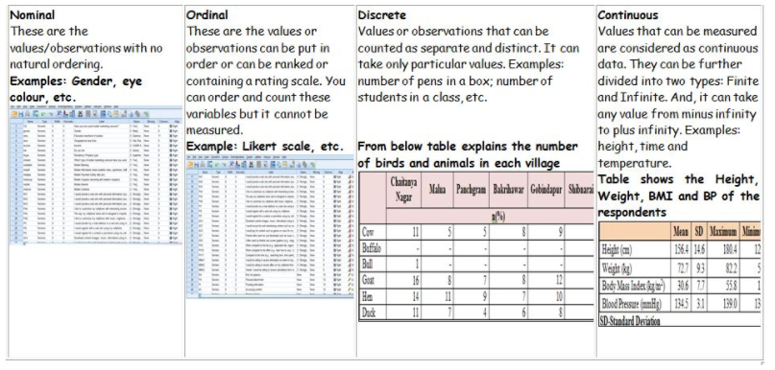
Types of Data
14

Slide 15
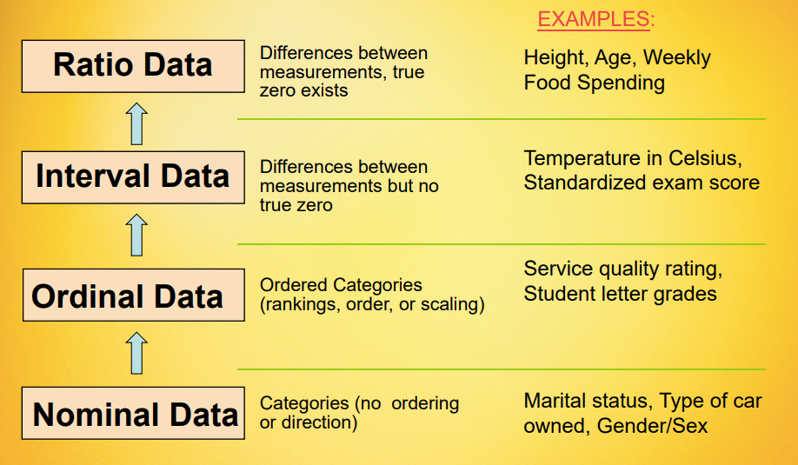
Measurement Scales
15

Slide 16


What type of statistic (descriptive or inferential) would you employ to answer the research questions below?
Select the appropriate category for each question.
DESCRIPTIVE STATISTICS | QUESTION | INFERENTIAL STATISTICS
 | We would like to know how many university students experience high stress levels.
 | We would like to know whether female students experience higher stress levels than male students.
 | We would like to know what study strategies are used by first year university students.
 | We would like to know whether there is are a relationship between university students' study strategies and their academic results.

Slide 17
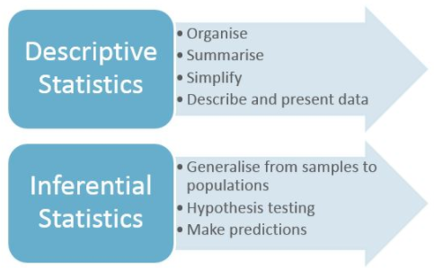
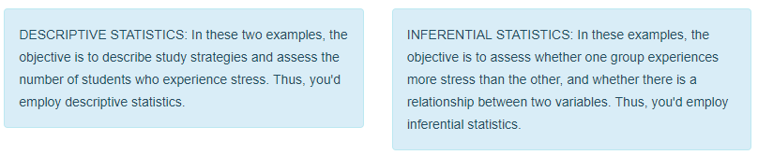

Slide 18
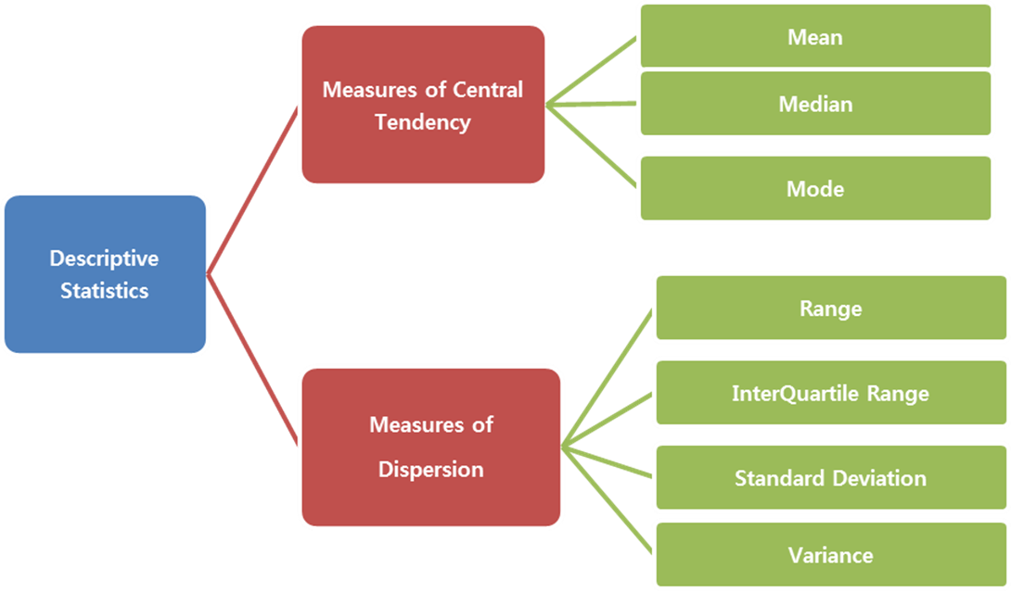
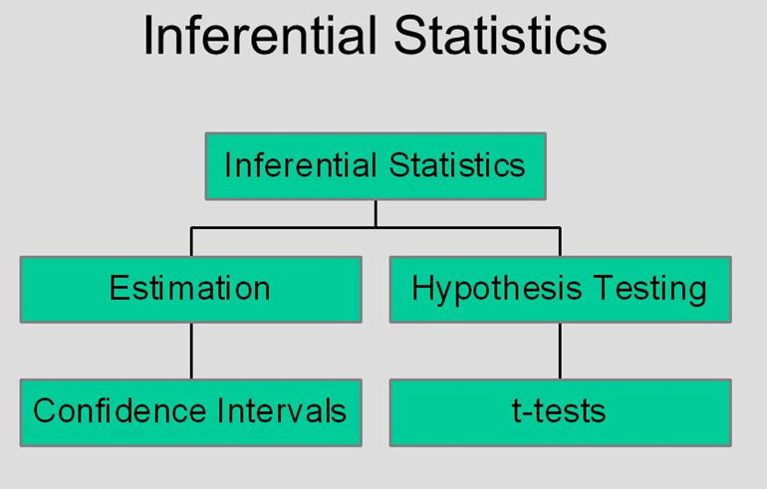

Slide 19

Key ideas from statistics that permeate data science:
Samples and populations
Sample statistics
Bootstrap
Outliers
Statistical models
Confounding and accounting for other factors
p-values

Slide 20
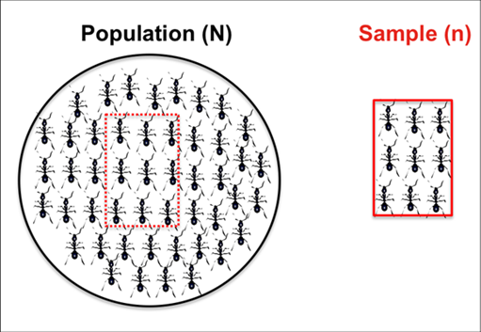
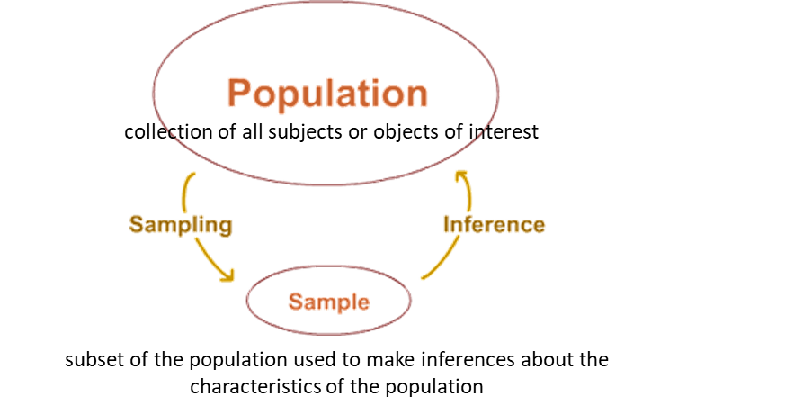
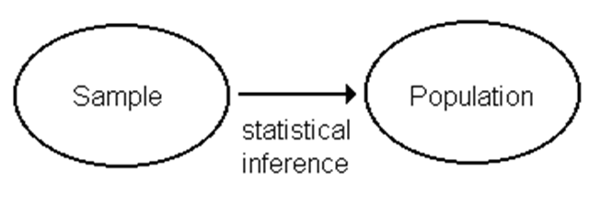
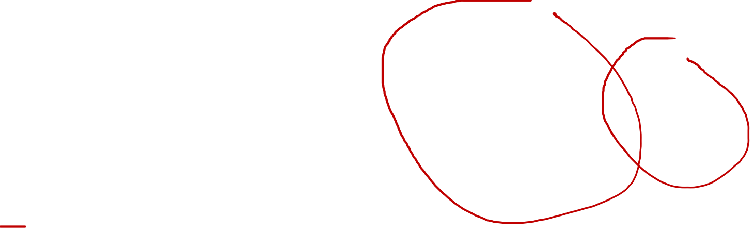
1. Samples and populations
The connection between the data we’ve got (the sample) and the population.
Basic concepts of statistics –
https://www.slideshare.net/tkjainbkn/basic-concepts-of-statistics-393112

Slide 21

Example: Sampling from Population
Suppose you were asked to help develop a travel policy for business travelers based in New York City.
Imagine that the traveler has a meeting in San Francisco (airport code SFO) at a specified time t.
The policy to be formulated will say how much earlier than t an acceptable flight should arrive in order to avoid being late to the meeting due to a flight delay.
The set of 336,776 flights in 2013 in the nycflights13 package, which gives airline delays from New York City airports in 2013.
http://moderndive.com/2-getting-started.html

Slide 22

nycflights13 package
This package contains five datasets saved as “data frames” with information about all domestic flights departing from New York City in 2013, from either Newark Liberty International (EWR), John F. Kennedy International (JFK), or LaGuardia (LGA) airports :

Slide 23
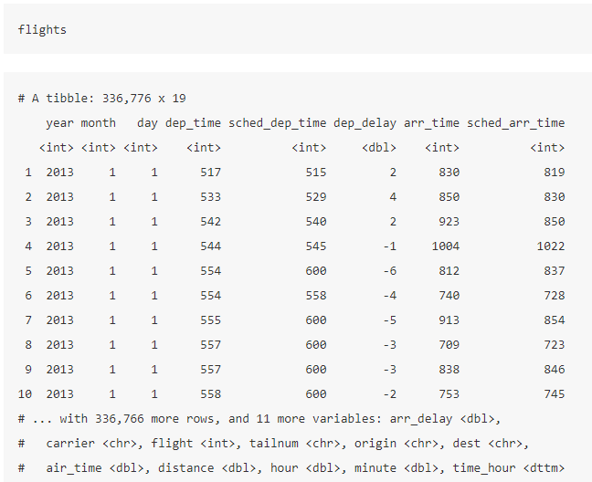
Dataset
Tibbles are data frames

Slide 24
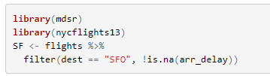
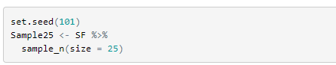
Simulate this situation by drawing a sample from the population of flights into SFO.
First set up the population.
Working with just a sample from the population, where sample size is n = 25

Slide 25
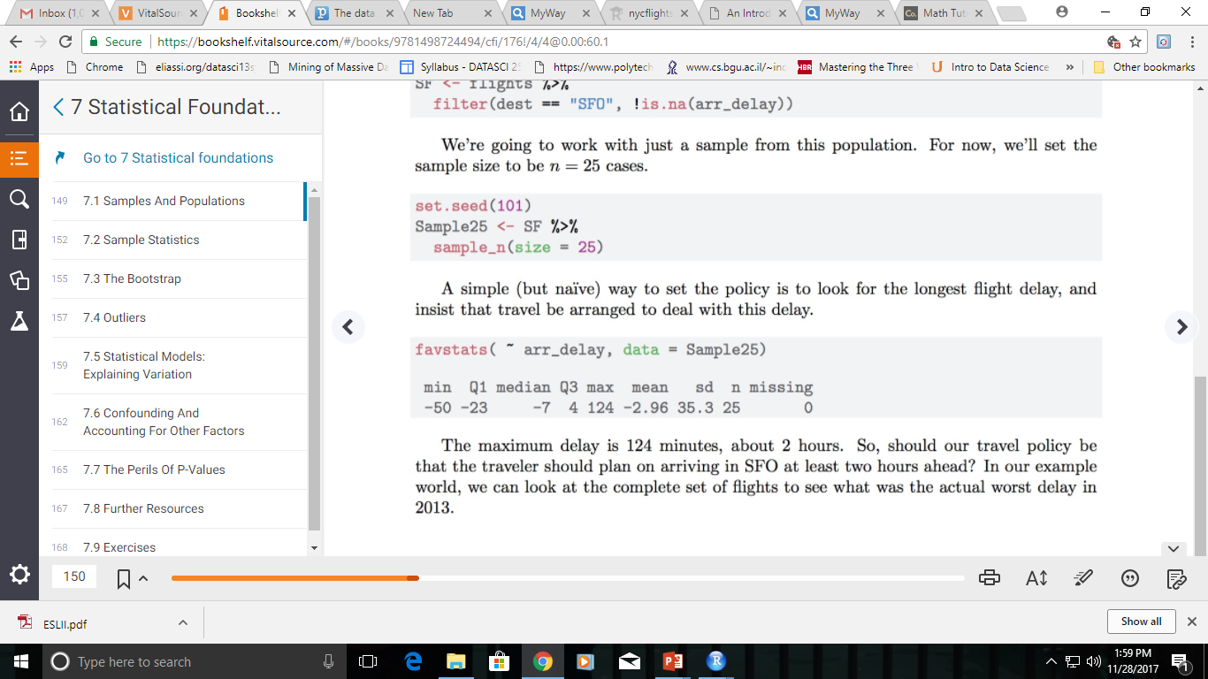
We are interested in the arrival delay. Focus on the variable arr_delay, and compute some useful statistics.
Notice that most of delays are less than 50 minutes, but the maximum delay is 124 minutes
The maximum delay is 124 minutes which is about 2 hours.
So, should the travel policy be that the traveler should plan on arriving in SFO at least 2 hours ahead?
What was the actual worst delay in 2013 if we compute on the complete set of flights?
Naive policy: book a flight that is scheduled to arrive at least 124 minutes before.
favstats() function in the mosaic package provides a concise summary of many useful statistics.

Slide 26
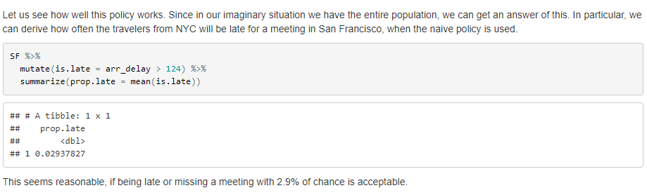
How well it will work?

Slide 27
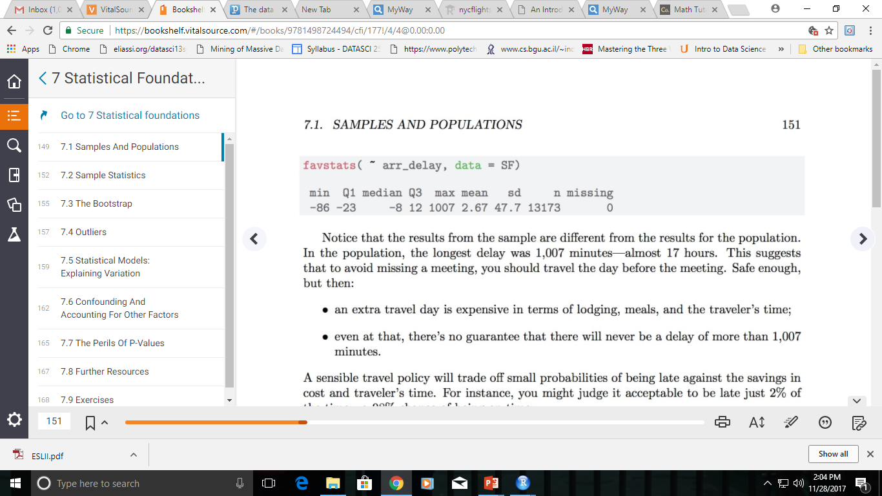

Working with the population, where the size is N = 336,776
What was the actual worst delay in 2013 if we compute on the complete set of flights?
The maximum delay is 1007 minutes which is about 17 hours.
Notice that the results from the sample are different from the results for the population.
This suggest that to avoid missing a meeting, one should travel the day before the meeting. Ok, but it is
costly in terms of lodging, meals etc.
No guarantee that there will never be a delay of more than 17 hours.

Slide 28
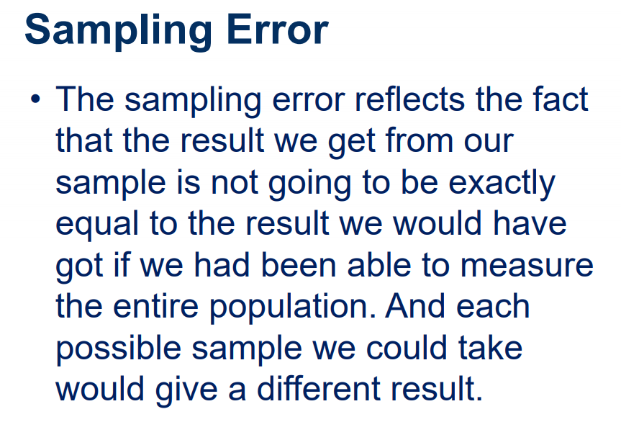
28

Slide 29
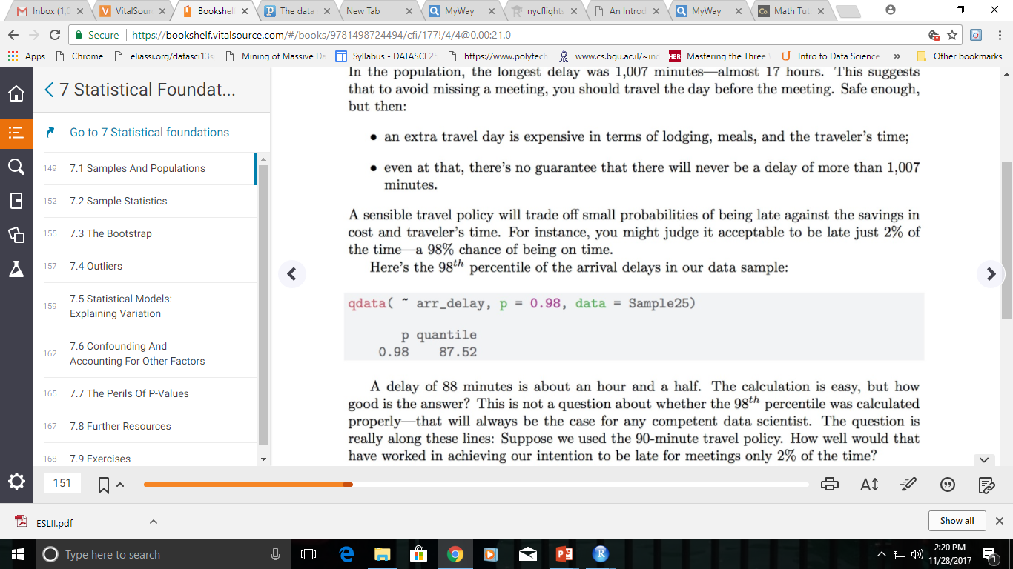
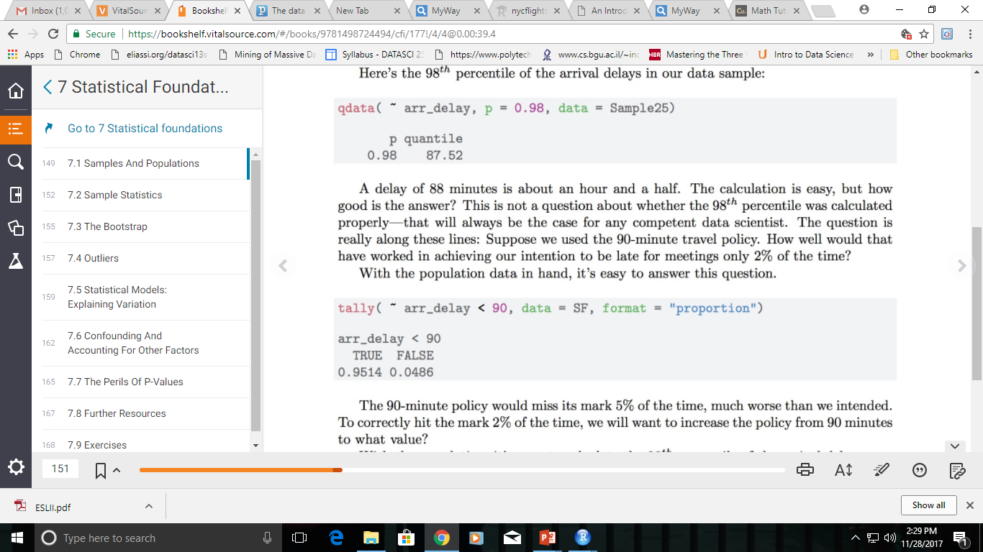

A practical travel policy will trade off small probabilities of being late against the savings in cost and traveler’s time. For instance, you might judge it acceptable to be late just 2% of the time—a 98% chance of being on time.
The 98th percentile of the arrival delays in our data sample:
The calculation is easy, but how good is the answer?
A delay of 88 minutes.
Suppose we used the 90-minute travel policy. How well would that have worked in achieving our intention to be late for meetings only 2% of the time? With the population data in hand, it’s easy to answer this question.
The 90-minute policy would miss its mark 5% of the time, much worse than we intended. To correctly hit the mark 2% of the time, we will want to increase the policy from 90 minutes to what value?

Slide 30
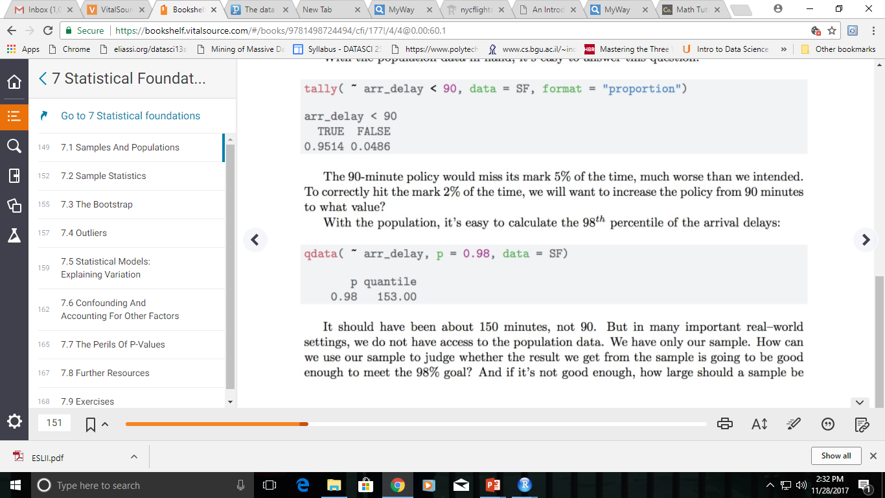

With the population, calculate the 98th percentile of the arrival delays:
It should have been about 150 minutes, not 90.
But in many important real–world settings, we do not have access to the population data. We have only our sample.
How can we use our sample to judge whether the result we get from the sample is going to be good enough to meet the 98% goal?
And if it’s not good enough, how large should a sample be to give a result that is likely to be good enough?
This is where the concepts and methods from statistics come in.

Slide 31

2. Sample Statistics
Characteristics of the sample such as the sample mean, the sample variance, and the sample proportion are called sample statistics.
It can be used to provide estimates of the corresponding population parameters.
e.g. % of voters in an opinion poll in Malaysia who think the Government is doing a good job to control inflation.
Null and alternative hypotheses are statements about population parameters.
More examples on next slide.

Slide 32
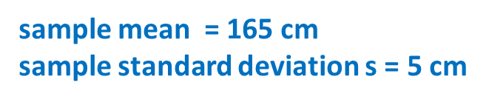
Heights of women, aged 25 - 29
Suppose you measured the heights of a random sample of 100 women aged 25-29 years and calculated
What can you conclude about the heights of all women in this population aged 25-29 years?
Supposing any bias is negligibly small, the population mean is approximately 165 cm. But how close is the approximation? How might the estimate have varied if a different random sample had been selected?
In parameter estimation, we assume that the distribution of the variable we are interested in is adequately described by a distribution with one or more (unknown) parameters. We attempt to estimate the population parameter using the sample data.
To emphasize the difference between sample and population, the parameters we wish to estimate are called population parameters.
Estimates of the population parameters obtained from a sample are called sample statistics (or sample estimates).

Slide 33

Sample statistics
How to define reliability?
The sample size is the number of cases in the sample, usually denoted with n. In the above, the sample size is n = 25.
The sampling distribution is the collection of the sample statistic from all of the trials. We carried out 500 trials here, but the exact number of trials is not important so long as it is large.
The shape of the sampling distribution is worth noting. Here it is a little skewed to the right.
The standard error is the standard deviation of the sampling distribution. It describes the width of the sampling distribution. For the trials calculating the sample mean in samples with n = 25, the standard error is 10.3 minutes.
We had access to the population data and so we could find the sampling distribution by repeatedly sampling from the population.

Slide 34
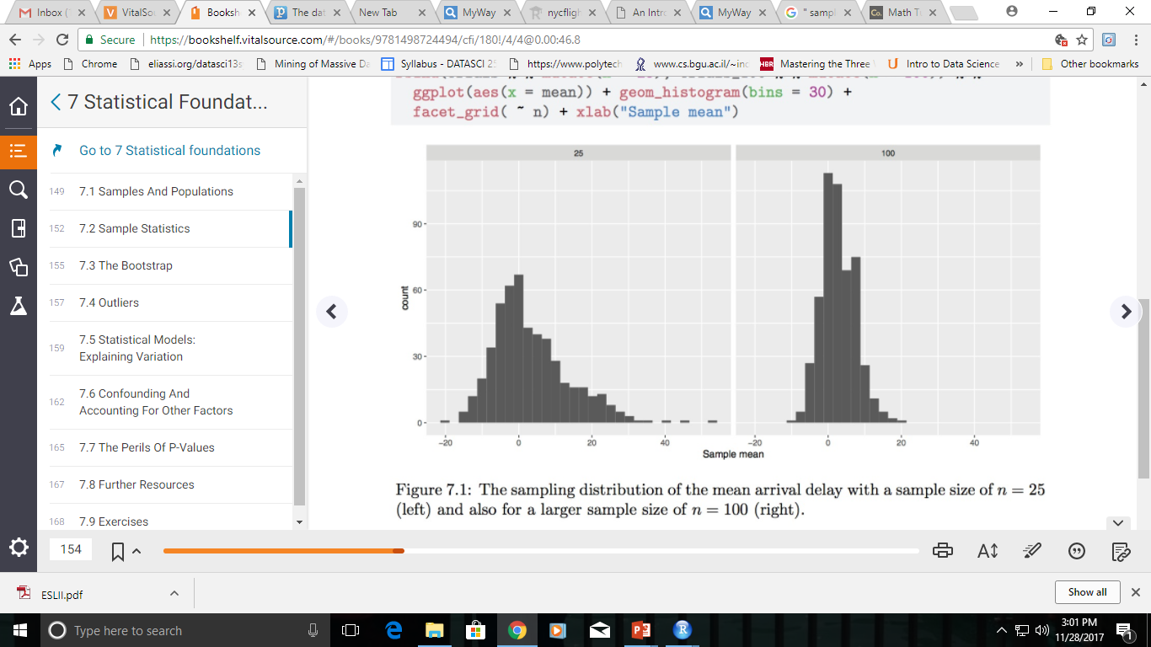
Comparing the two sampling distributions, one with n = 25 and the other with n = 100 shows some patterns that are generally true for statistics such as the mean:
Both sampling distributions are centered at the same value.

Slide 35
A larger sample size produces a standard error that is smaller. That is, a larger sample size is more reliable than a smaller sample size. You can see that the standard deviation for n = 100 is one-half that for n = 25. As a rule, the standard error of a √ sampling distribution scales as 1/ √n.
For large sample sizes n, the shape of the sampling distribution tends to bell-shaped. In a bit of archaic terminology, this shape is often called the normal distribution. Indeed, the distribution arises very frequently in statistics, but there is nothing abnormal about any other distribution shape.
The reliability of a sample statistic is typically measured by
the mean of the statistic (mean of the sampling distribution). Better if it is closer to the truth.
the standard error of the statistic (standard of the sampling distribution). Better if it is small.

Slide 36
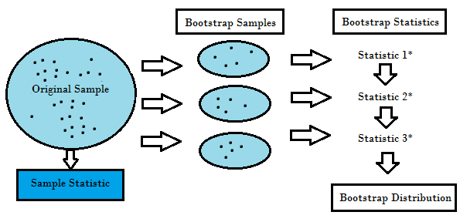
3. Bootstrap
A bootstrap sample is a smaller sample that is “bootstrapped” from a larger sample. Bootstrapping is a type of resampling where large numbers of smaller samples of the same size are repeatedly drawn, with replacement, from a single original sample.
Bootstrapping is loosely based on the law of large numbers, which states that if you sample over and over again, your data should approximate the true population data.

Slide 37
Law of Large Numbers
It is a theorem that describes the result of performing the same experiment a large number of times.
This theorem forms the basis of frequency-style thinking.
It says that the sample mean, the sample variance and the sample standard deviation converge to what they are trying to estimate.
Example: roll a dice, expected value is 3.5. For a large number of experiments, the average converges to 3.5.
Bootstrapping is random sampling from the sample with replacement.

Slide 38
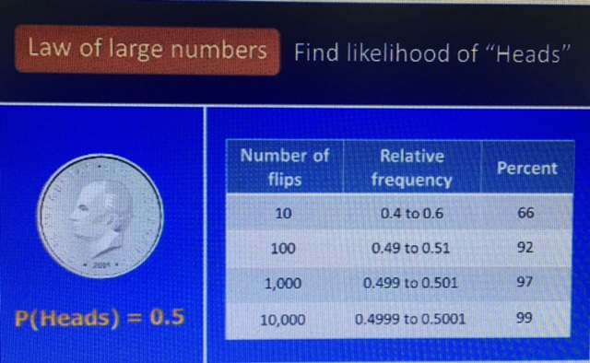

Slide 39
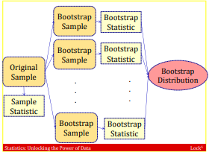
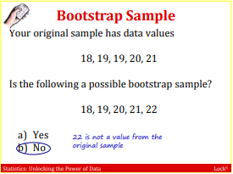
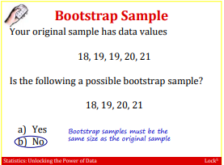
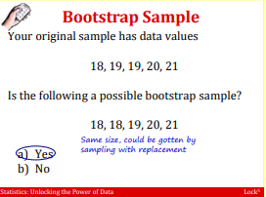
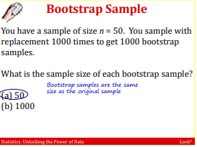
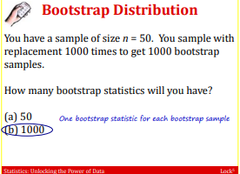

Credit to source from: https://www2.stat.duke.edu/courses/Fall12/sta101.002/Sec3-34.pdf

Slide 40
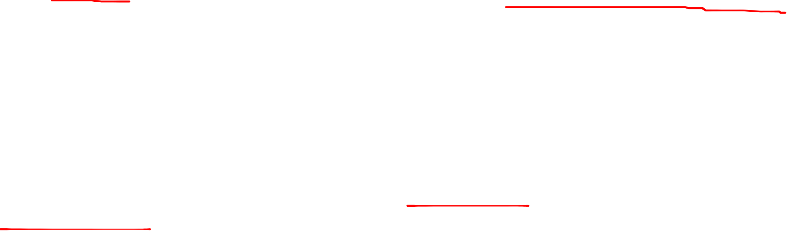
Bootstrap
We only have one sample and not the entire population.
The bootstrap is a statistical method that allows us to approximate the sampling distribution even without access to the population.
The logical leap involved in the bootstrap is to think of our sample itself as if it were the population.
Just as in the previous examples we drew many samples from the population, now we will draw many new samples from our original sample. This process is called resampling: drawing a new sample from an existing sample.
When sampling from a population, we would of course make sure not to duplicate any of the cases. When resampling, however, we do allow such duplication.

Slide 41
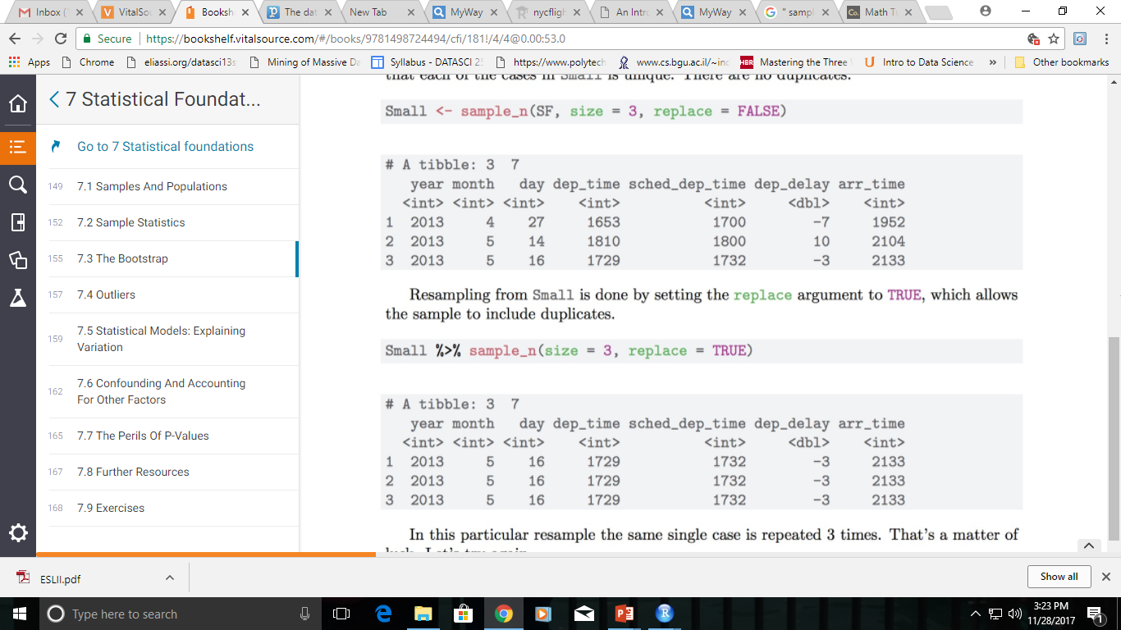
No duplication

Slide 42
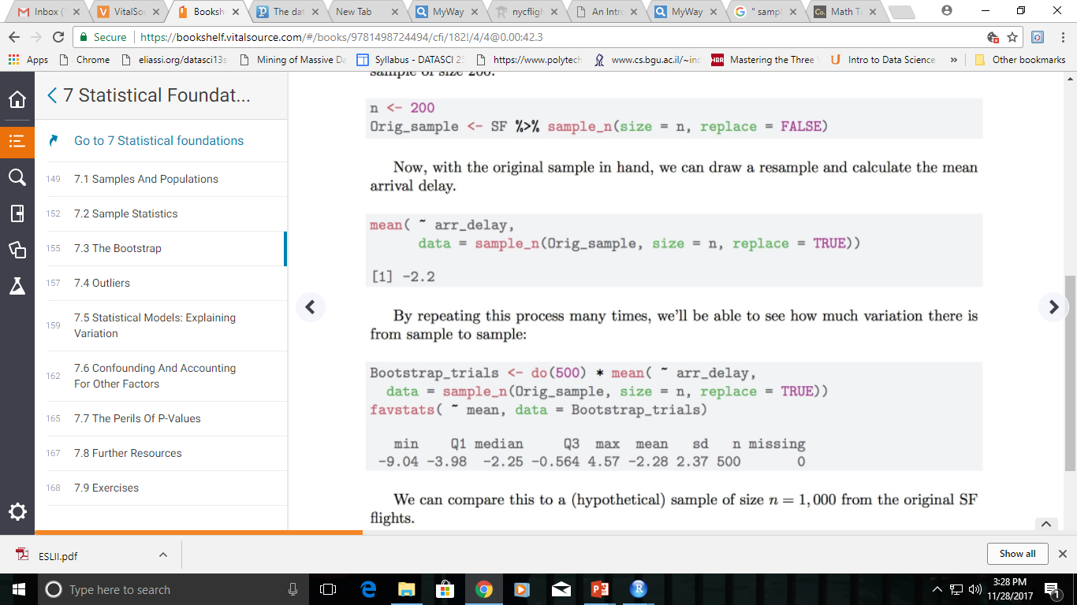
Using bootstrapping to find the reliability of the mean arrival time calculated on a sample of size 200.

Slide 43
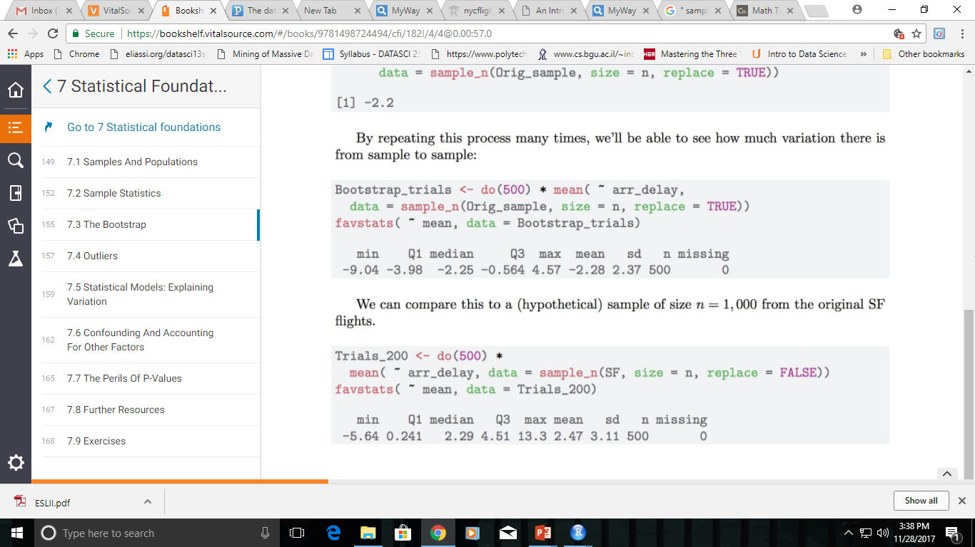
What’s remarkable here is that the standard error calculated in this way, 2.4 minutes, is a reasonable approximation to the standard error of the sampling population calculated in the previous section (3.1 minutes).
The distribution of values in the bootstrap trials is called the bootstrap distribution. It’s not exactly the same as the sampling distribution, but for moderate to large sample sizes it has been proven to approximate those aspects of the sampling distribution that we care most about, such as the standard error.

Slide 44
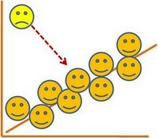
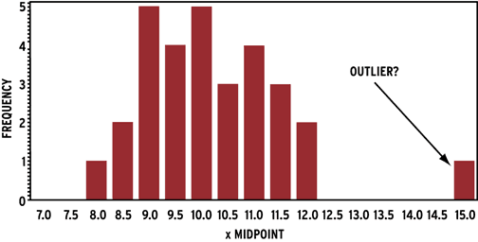
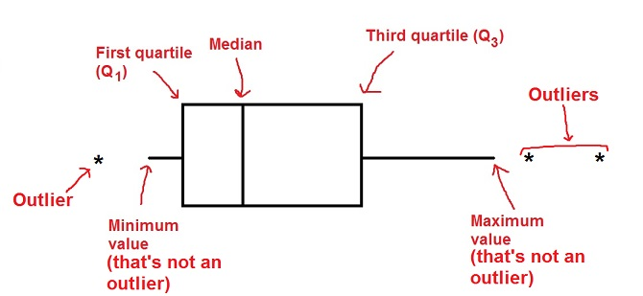

4. Outliers
An observation that lies an abnormal distance from other values in a random sample from a population.
The most common ways to treat outlier values –
1) To change the value and bring in within a range
2) To just remove the value.

Slide 45
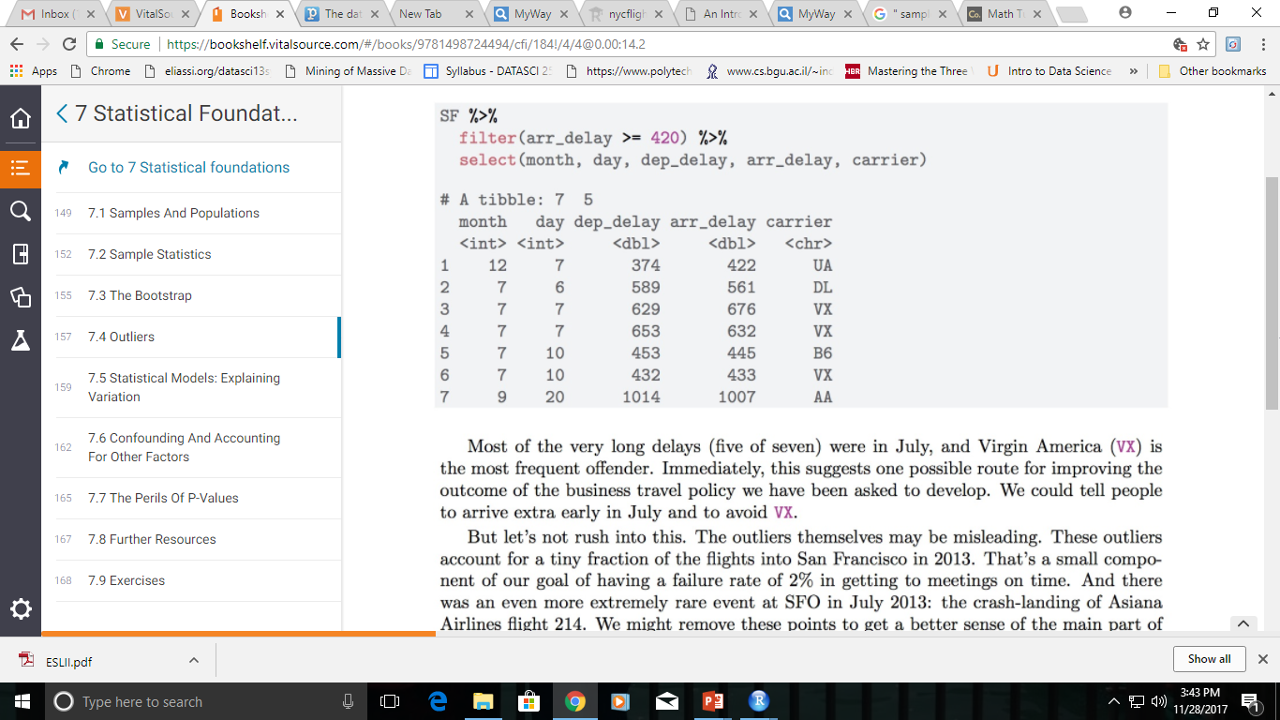

Outliers
One place where more data is helpful is in identifying unusual or extreme events: outliers.
Suppose we consider any flight delayed by seven hours (420 minutes) or more as an extreme event.
Arrive extra early in July and to avoid VX flight.

Slide 46

Reminder on Outliers
Outliers can often tell us interesting things.
How they should be handled depends on their cause.
Outliers due to data irregularities or errors should be fixed.
Other outliers may yield important insights.
Outliers should never be dropped unless there is a clear rationale. If outliers are dropped this should be clearly reported.

Slide 47

5. Statistical Model
A statistical model is a special class of mathematical model.
What distinguishes a statistical model from other mathematical models is that a statistical model is non-deterministic. Thus, in a statistical model specified via mathematical equations, some of the variables do not have specific values, but instead have probability distributions; i.e. some of the variables are stochastic (something that was randomly determined).
There are three purposes for a statistical model,
Predictions
Extraction of information
Description of stochastic structures

Slide 48

Model: A representation for a purpose. Blueprints, dolls, model airplanes.
Mathematical model: a description of a system using mathematical concepts and language.
can take many forms, including dynamical systems, statistical models, differential equations, or game theoretic models.
Statistical model: A class of mathematical model founded on data.
embodies a set of assumptions concerning the generation of some sample data, and similar data from a larger population.
What distinguishes a statistical model from other mathematical models is that a statistical model is non-deterministic.
A system in which the output cannot be predicted because there are multiple possible outcomes for each input.

Slide 49





Two purposes for a statistical model:
To extract some information about how nature is associating the response variables to the input variables.
To be able to predict what the responses are going to be to future input variables
Source: Statistical Modeling: The Two Cultures- by Leo Breiman
49

Slide 50


5. Statistical models: Explaining variation.
Statistical modeling provides a way to relate variables to one another. What impact, if any, does scheduled time of departure have on expected flight delay?

Slide 51

Let’s examine how the arrival delay depends on the hour. Can do in 2 ways: First using standard box-and-whiskers to show the distribution of arrival delays; Second with a kind of statistical model over the course of the day.
Figure 7.3: Association of flight arrival delays with scheduled departure time for flights to San Francisco from New York airports in 2013.

Slide 52



lm() to construct what are called linear models.
Linear models describe how the mean of the response variable varies with the explanatory variables. They are the most widely used statistical modeling technique.
The number under the “Estimate” for hour indicates that the arrival delay increases by about 2 minutes per hour. Over the 15 hours of flights, this leads to a 30-minute increase in arrival delay for flights at the end of the day.
The msummary() function also calculates the standard error: 0.09 minutes per hour. Or, stated as a 95% confidence interval, this model indicates that arrival delay increases by 2.0 ± 0.18 minutes per hour. The rightmost column gives the p-value, a way of translating the estimate and standard error onto a scale from zero to one.
By convention, p-values below 0.05 provide a kind of certificate testifying that random, accidental patterns would be unlikely to generate an estimate as large as that observed.

Slide 53



6. Confounding and Accounting for Other Factors
“Correlation does not imply causation”
While the statement is certainly true, there are times when correlations do imply causal relationships
Confounding variables - These are extraneous variables in a statistical model that correlate directly or inversely with both the dependent and the independent variable. The estimate fails to account for the confounding factor.
aka third variables

Slide 54



Confounding Variables

Slide 55


Data scientists spend most of their time working with observational data.
When seeking to find meaning from such data, it is important to be on the lookout for potential confounding factors that could distort observed associations.
Let’s consider an example using data on average teacher salaries and average total SAT scores for the 50 United States. The SAT (Scholastic Aptitude Test) is a high-stakes exam used for entry into college. Are higher teacher salaries associated with better outcomes on the test at the state level?

Slide 56




Slide 57



Lurking in the background is another important factor!
% of students who take the SAT in each state varies dramatically (from 3 – 93% in 2010).
Create a variable (SAT grp) that divides the states into two groups.

Slide 58


Scatter plot, stratified by the % of students taking the SAT in each state.

Slide 59



Stratification
Stratification (simply means grouping) can control the confounding variable sat_grp.
For each group given by the values of sat_grp, average teacher salary is positively associated with average SAT score.
When we collapse over this variable, average teacher salary is negatively associated with average SAT score. (sat_grp or sat_pct is confounding here.)
This form of confounding is called Simpson’s paradox.

Slide 60

Multiple regression is another way of controlling confounding variables.
The slope for Salary is positive and statistically significant when we control for sat_pct.

Slide 61
Strategies to reduce confounding
Randomization (aim is random distribution of confounders between study groups)
Matching (of individuals or groups, aim for equal distribution of confounders)
Stratification (confounders are distributed evenly within each stratum)
Adjustment (usually distorted by choice of standard)
Multivariate analysis (only works if you can identify and measure the confounders)

Slide 62

7. p-Values
The P value is used all over statistics, from t-tests to regression analysis.
P-value is used to determine the significance of results after a hypothesis test in statistics.
P-value helps the readers to draw conclusions and is always between 0 and 1.
P- Value > 0.05 denotes weak evidence against the null hypothesis which means the null hypothesis cannot be rejected.
P-value <= 0.05 denotes strong evidence against the null hypothesis which means the null hypothesis can be rejected.
P-value = 0.05 is the marginal value indicating it is possible to go either way.
A result is called “statistically significant” whenever the p-value is less or equal to the significance level.

Slide 63

The Dean & management team are trying to test whether a new academic program attracts more students.
What would be the null hypothesis and alternate hypothesis for this case?
The null hypothesis is that there is no change in the number of students as a result of the new academic program.
The alternate hypothesis is that the new academic program attracts more students than the existing program.

Slide 64

Determine and elaborate the role of p-value in statistical hypothesis testing. What is the meaning when p-value = 0.40 or p-value = 0.05?
The p-value is the probability that the null hypothesis is true. If the value of the p-value is 0.40, then there is a 40% probability that there is no real increase in students numbers as a result of the new academic program.
If the value of the p-value is 0.05 then there is a 5% probability that there is an increase in students numbers as a result of the new academic program.
As you can conclude, the lower the p-value, the more confident we are that the alternate hypothesis is true, which, in this case, means that the new academic program attracts more students than the existing program.
When we execute a hypothesis test in statistics, a p-value helps us in determine the significance of our results.
These Hypothesis tests are nothing but to test the validity of a claim that is made about a population. A null hypothesis is a situation when the hypothesis and the specified population is with no significant difference due to sampling or experimental error.

Slide 65
Unfortunately, we never know with 100% certainty what is true in reality. We always make our decision based on sample data, which may or may not reflect reality. So we'll make our decision, but it may not always be correct.
In general, there are four possible outcomes from a hypothesis test when we compare our decision with what is true in reality - which we will never know!
We could decide to not reject the null hypothesis when in reality the null hypothesis was true. This would be a correct decision.
We could reject the null hypothesis when in reality the alternative hypothesis is true. This would also be a correct decision.
We could reject the null hypothesis when it really is true. We call this error a Type I error.
We could decide to not reject the null hypothesis, when in reality we should have, because the alternative was true. We call this error a Type II error.

Slide 66

Let's consider a murder trial, with a possibility of death penalty if the defendant is convicted. The null and alternative hypotheses again are:
H0: the defendant is innocent
H1: the defendant is guilty
In this case, a Type I error (rejecting the null when it really is true) would be when the jury returns a "guilty" verdict, when the defendant is actually innocent.

Slide 67
Type I error and Type II error
A type I error occurs when the null hypothesis is true, but is rejected.
A type I error, or false positive, is asserting something as true when it is actually false. This false positive error is basically a "false alarm" – a result that indicates a given condition has been fulfilled when it actually has not been fulfilled (i.e., erroneously a positive result has been assumed).
A type II error occurs when the null hypothesis is false, but erroneously fails to be rejected.
A type II error, or false negative, is where a test result indicates that a condition failed, while it actually was successful. A Type II error is committed when we fail to believe a true condition.

Slide 68

False Positives are the cases where you wrongly classified a non-event as an event a.k.a Type I error.
False Negatives are the cases where you wrongly classify events as non-events, a.k.a Type II error.

Slide 69

The Four Outcomes of Hypothesis Testing
 | Null Hypothesis is true | Null hypothesis is false
Reject null hypothesis | Type I Error False Positive | Correct Outcome True Positive
Fail to reject null hypothesis | Correct outcome True Negative | Type II Error False Negative

Slide 70

American Statistical Association endorsed a statement on p-values - Six principles:
P-values can indicate how incompatible the data are with a specified statistical model.
P-values do not measure the probability that the studied hypothesis is true, or the probability that the data were produced by random chance alone.
Scientific conclusions and business or policy decisions should not be based only on whether a p-value passes a specific threshold.
Proper inference requires full reporting and transparency.
A p-value, or statistical significance, does not measure the size of an effect or the importance of a result.
By itself, a p-value does not provide a good measure of evidence regarding a model or hypothesis.

Slide 71


Imagine that you are CEO of Amazon, and trying to work out whether rearranging your website into a new format affects conversion rate (i.e. the proportion of visitors to Amazon who become customers):
One approach would be to run both versions to selected customers and make a judgement based on these numbers alone:
Type I error — or falsely concluding that your intervention was successful (which here might be falsely concluding that layout B is better than Layout A). Also known as a false positive result.
Type II error — falsely concluding that your intervention was not successful. Also known as a false negative result.
In this case we would conclude that Layout B is superior to Layout A.
However, such a simple approach suffers from two possible errors that statistics students will be very familiar with:
An A/B test - enable to accurately quantify the effect size and errors, and so calculate the probability type I or type II error.
https://towardsdatascience.com/data-science-you-need-to-know-a-b-testing-f2f12aff619a
https://www.tutorialspoint.com/ab_testing/index.htm

Slide 72
What is A/B testing?
Two-sample hypothesis testing
Randomized experiments with two variants: A and B
A: control; B: variation
User-experience design: identify changes to web pages that increase clicks on a banner.
Current website: control; NULL hypothesis
New version: variation; alternative hypothesis

Slide 73

More Resources
> swirl::install_course("Statistical Inference")
https://github.com/swirldev/swirl_courses

